Slide 1
Black holes from black boxes
(este slide será substituído por uma imagem)
Rodrigo Carvajal
Instituto de Astrofísica e Ciências do Espaço (IA)
Faculdade de Ciências da Universidade de Lisboa (Ciências ULisboa)

Slide 2
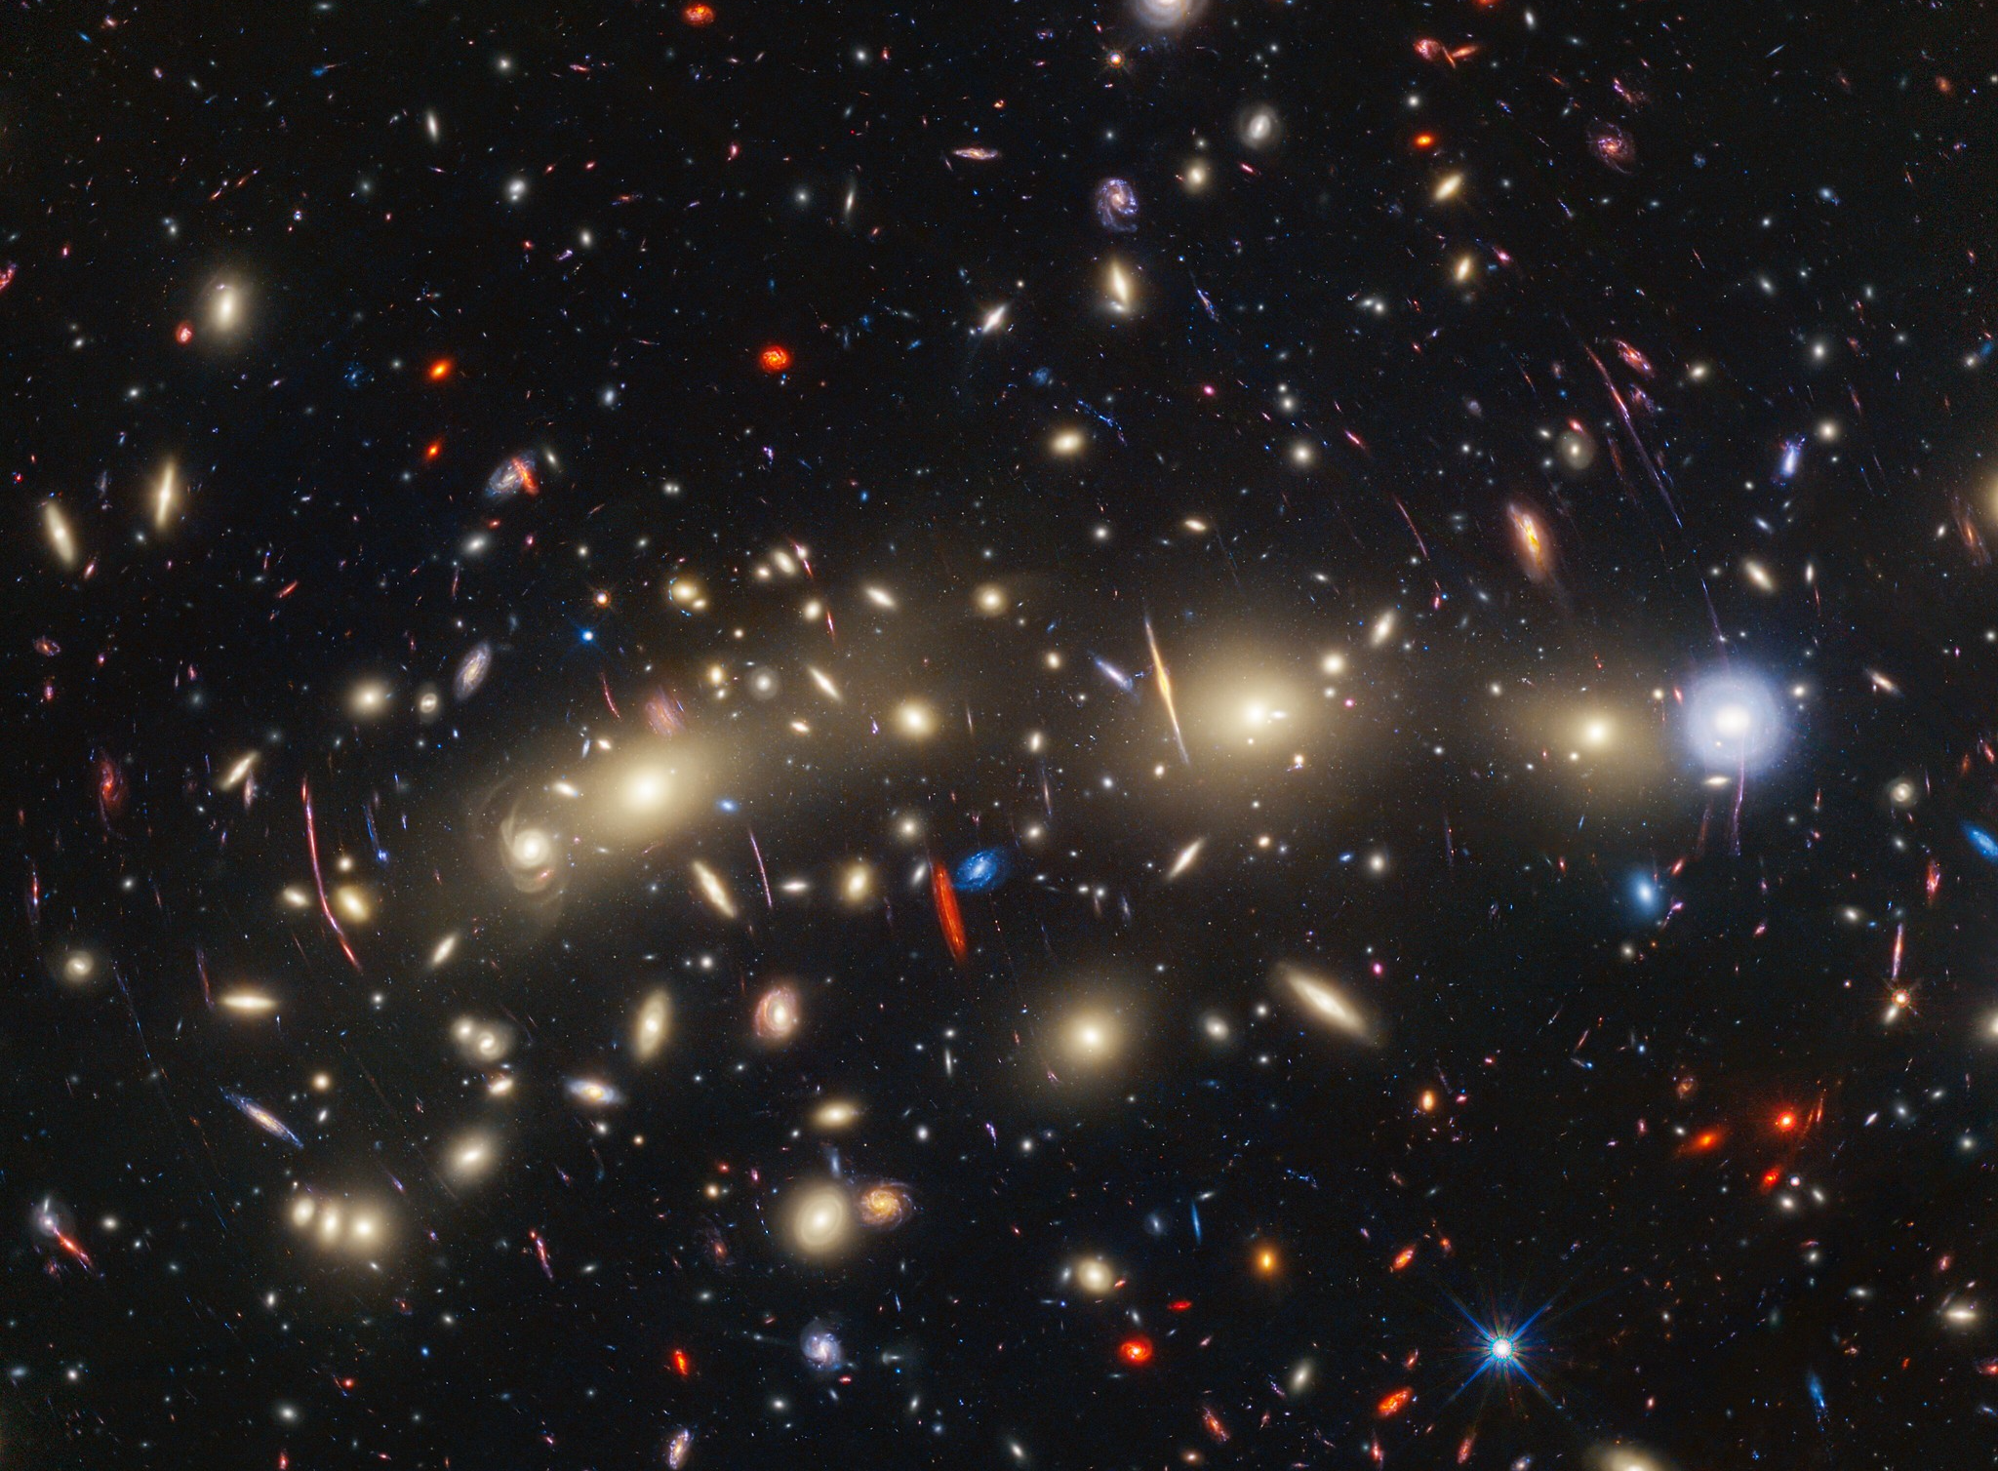

Credit: NASA, ESA, CSA, STScI, Jose M. Diego (IFCA), Jordan C. J. D'Silva (UWA), Anton M. Koekemoer (STScI), Jake Summers (ASU), Rogier Windhorst (ASU), Haojing Yan (University of Missouri)
Black holes from black boxes Rodrigo Carvajal

Slide 3
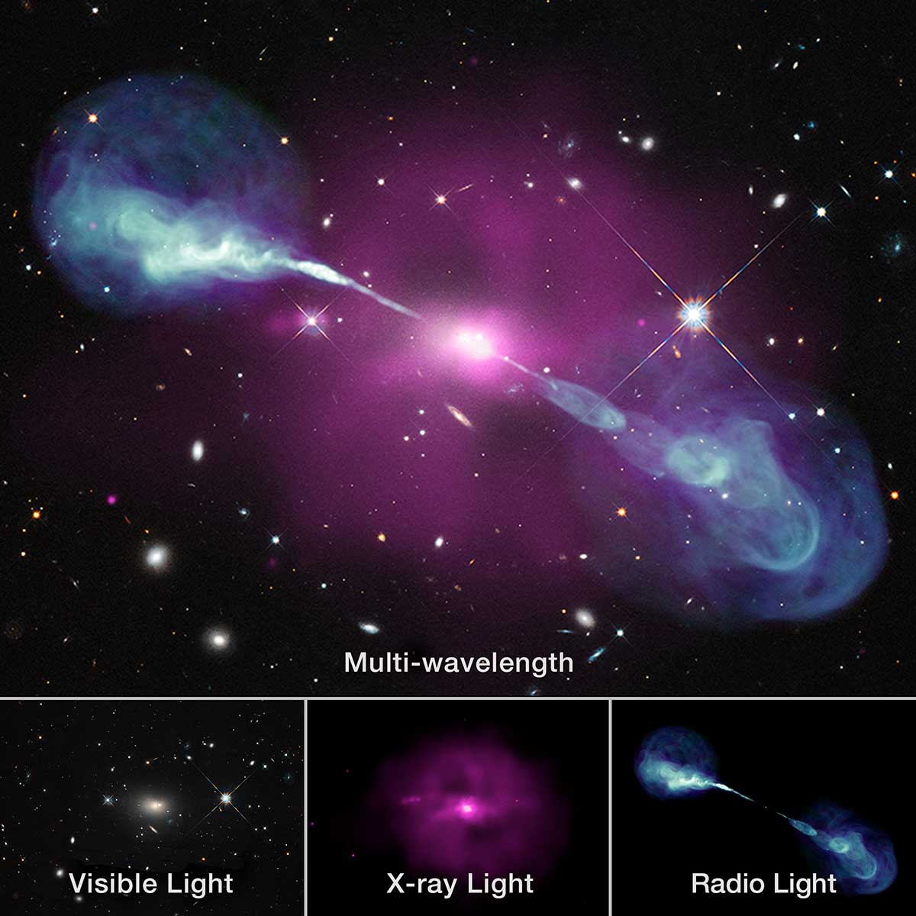
Credit: X-ray: NASA/CXC/SAO; visual: NASA/STScI; radio: NSF/NRAO/VLA
Black holes from black boxes Rodrigo Carvajal

Slide 4
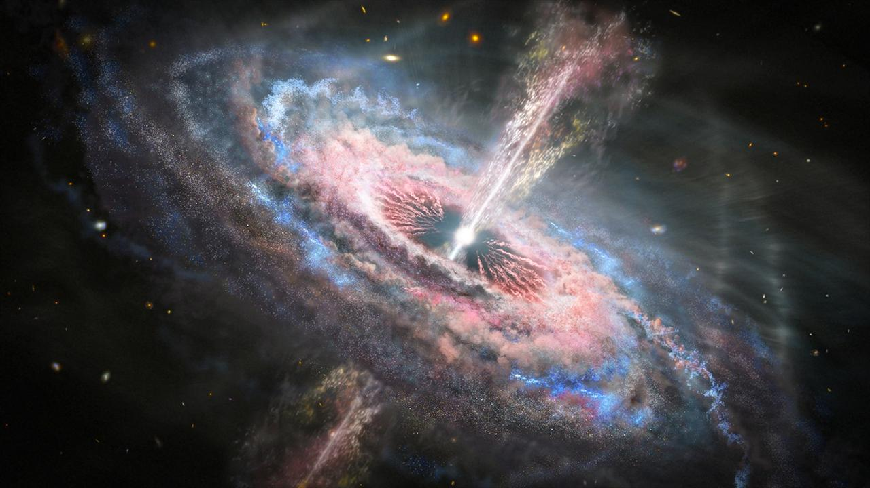
NASA, ESA and J. Olmsted (STScI)
Black holes from black boxes Rodrigo Carvajal

Slide 5
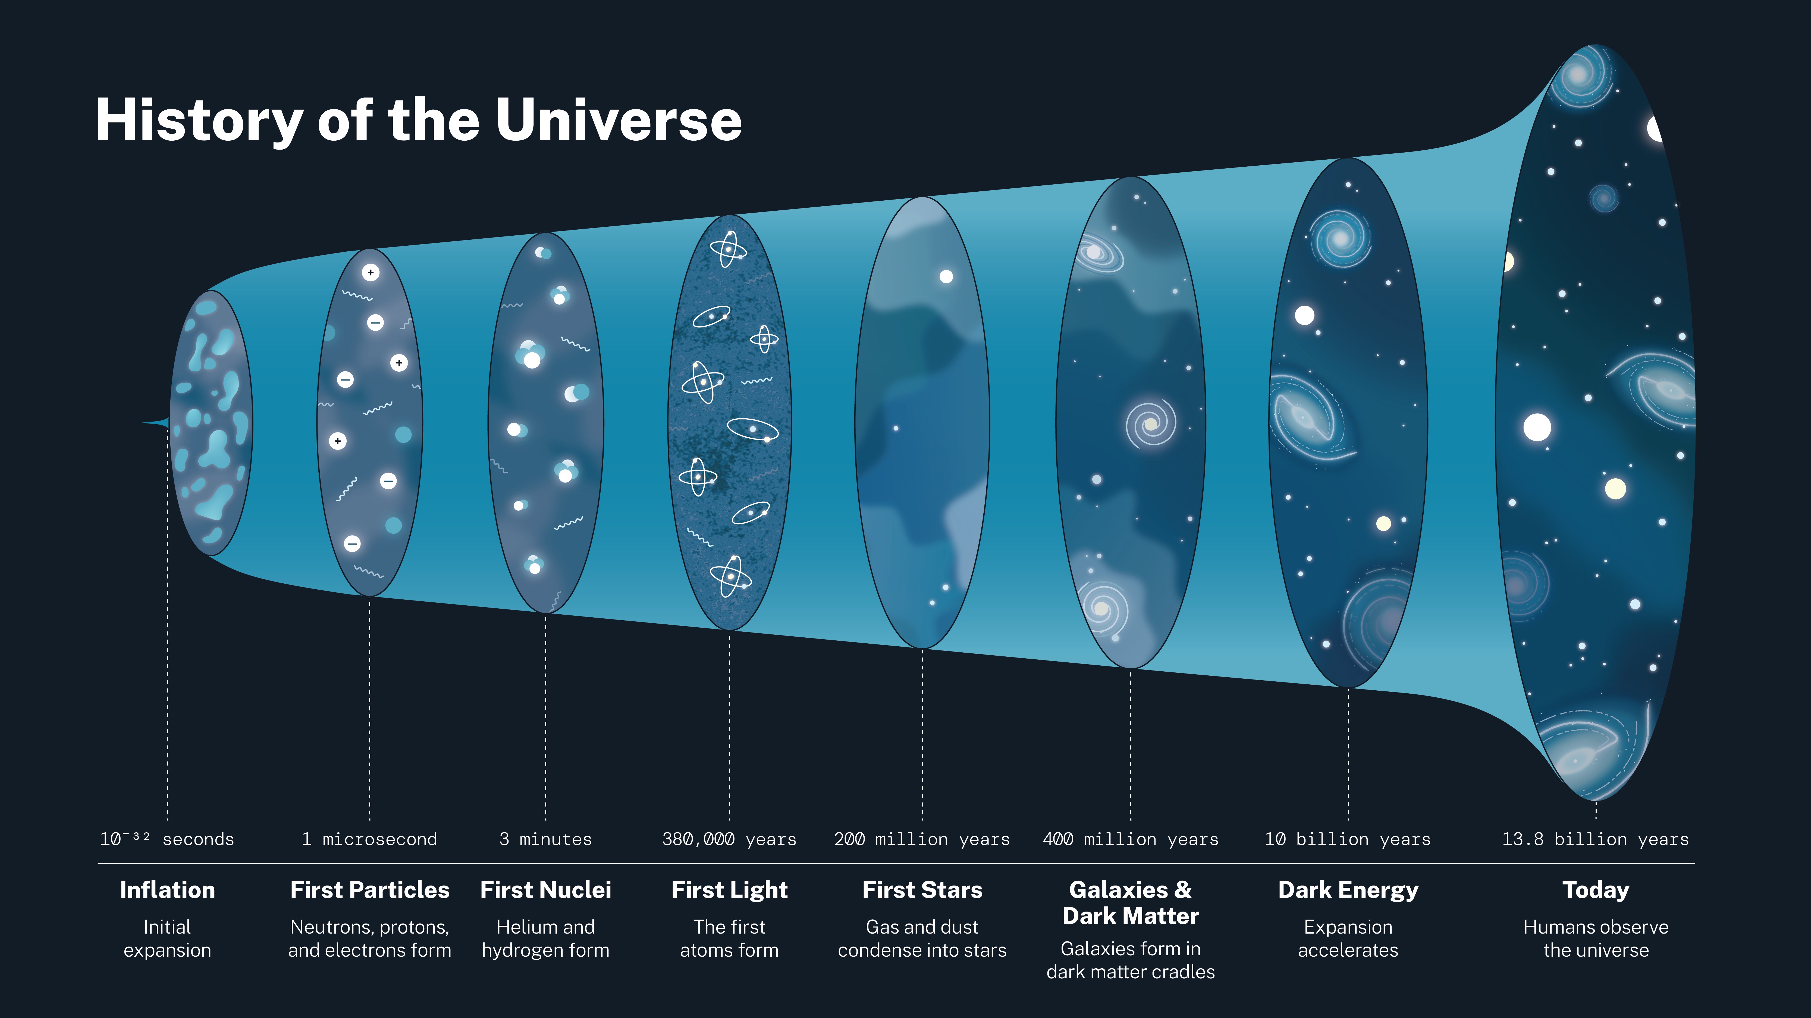
Reionisation
20 ≳ z ≳ 6
NASA
Black holes from black boxes Rodrigo Carvajal

Slide 6
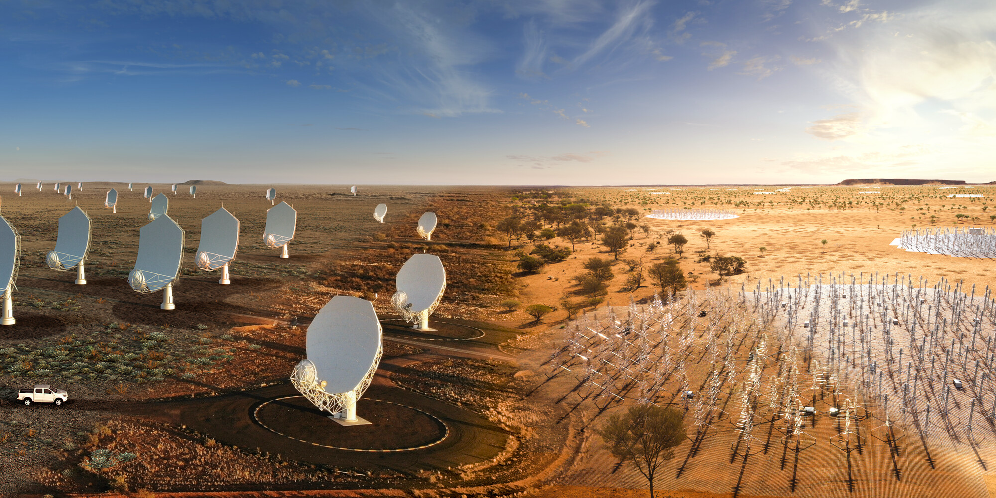
© SKAO
Black holes from black boxes Rodrigo Carvajal

Slide 7
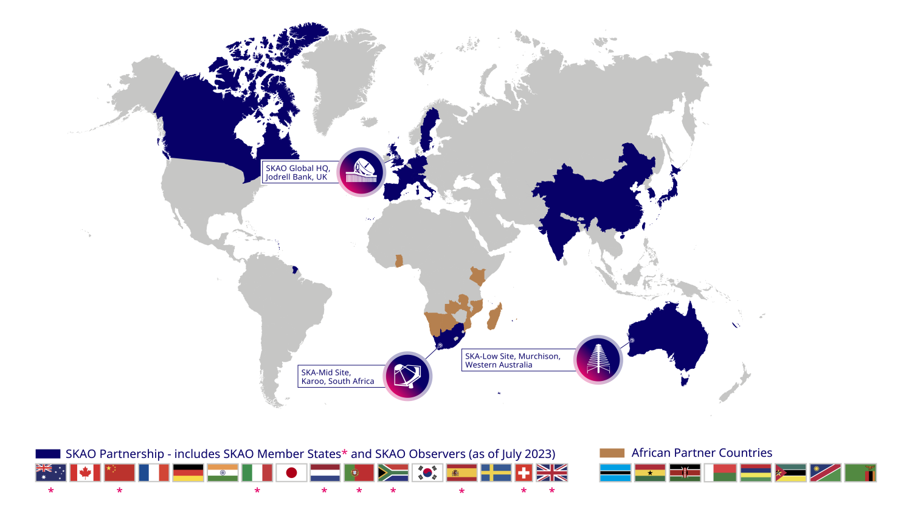
Black holes from black boxes Rodrigo Carvajal

Slide 8
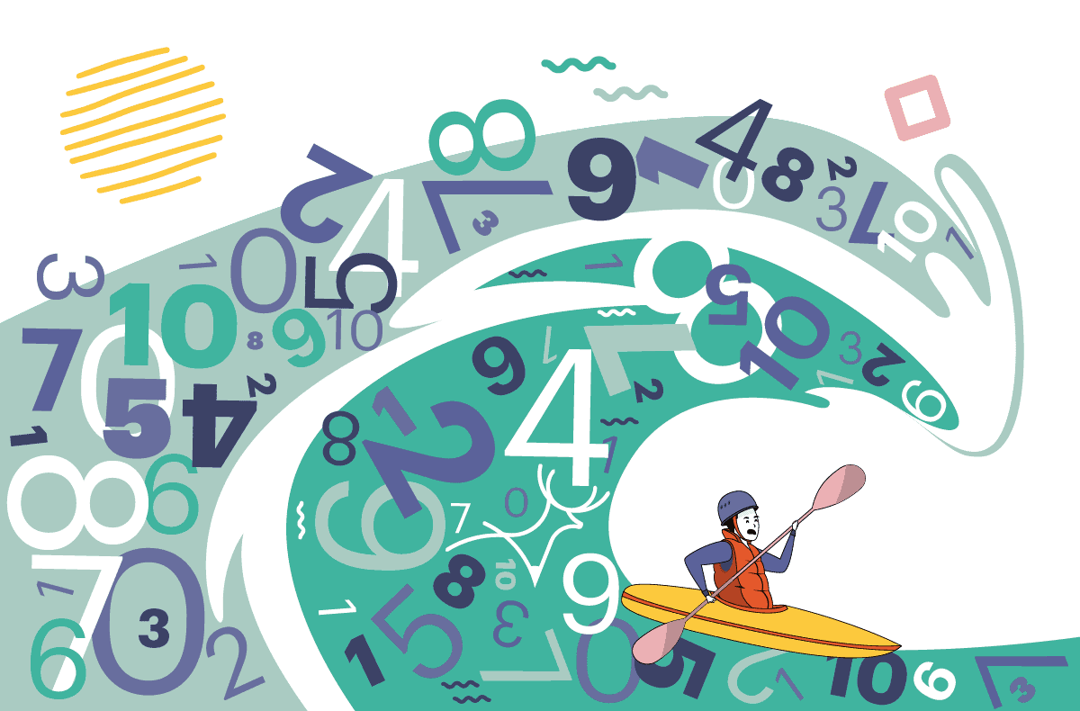
NASA, ESA and J. Olmsted (STScI)
Black holes from black boxes Rodrigo Carvajal

Slide 9
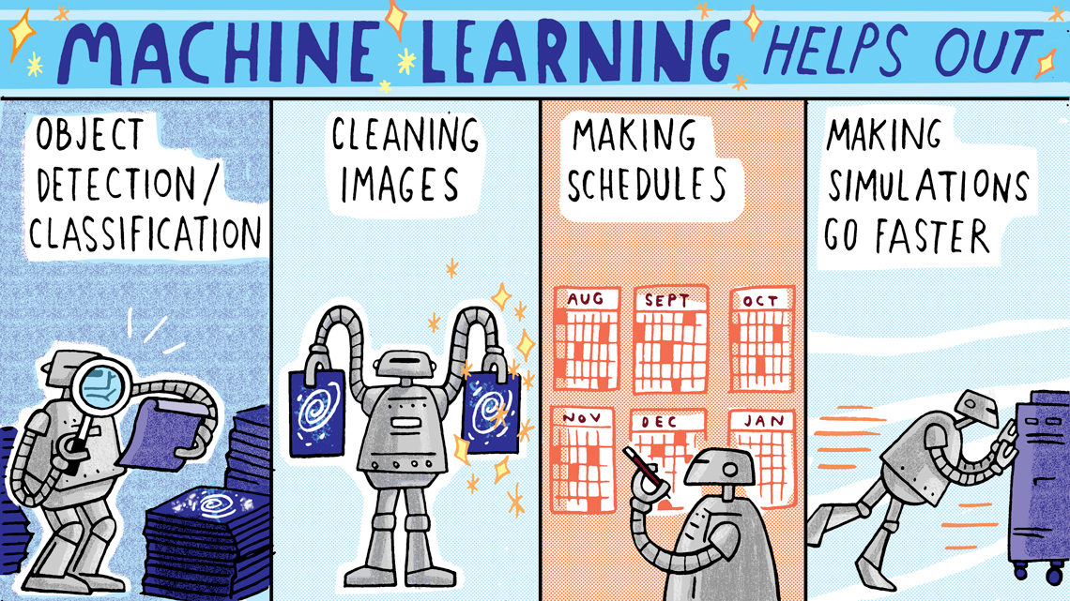
Illustration by Sandbox Studio, Chicago with Corinne Mucha
Black holes from black boxes Rodrigo Carvajal

Slide 10
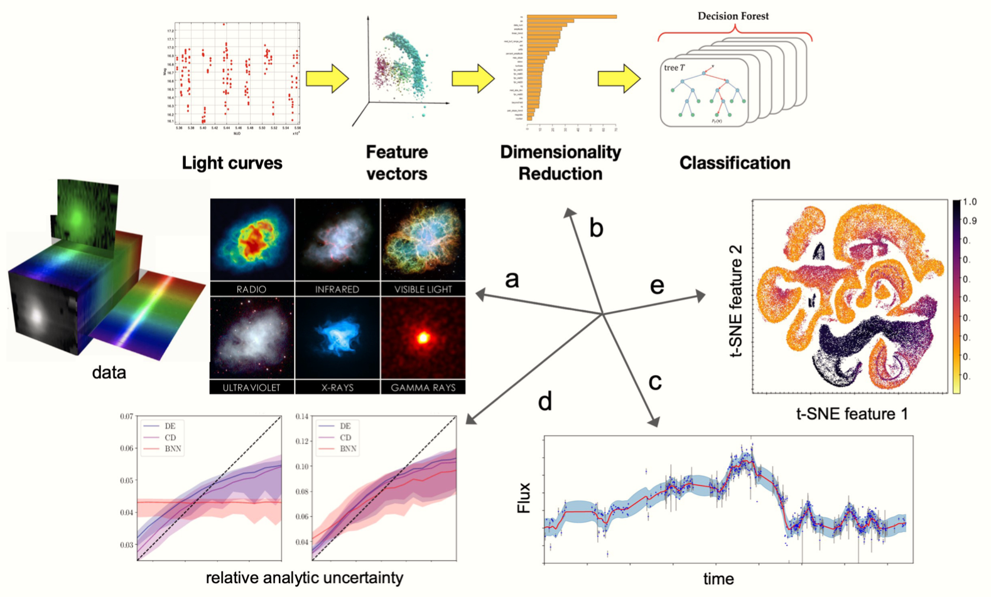
Djorgovski, Mahabal, et al. 2023
Black holes from black boxes Rodrigo Carvajal

Slide 11
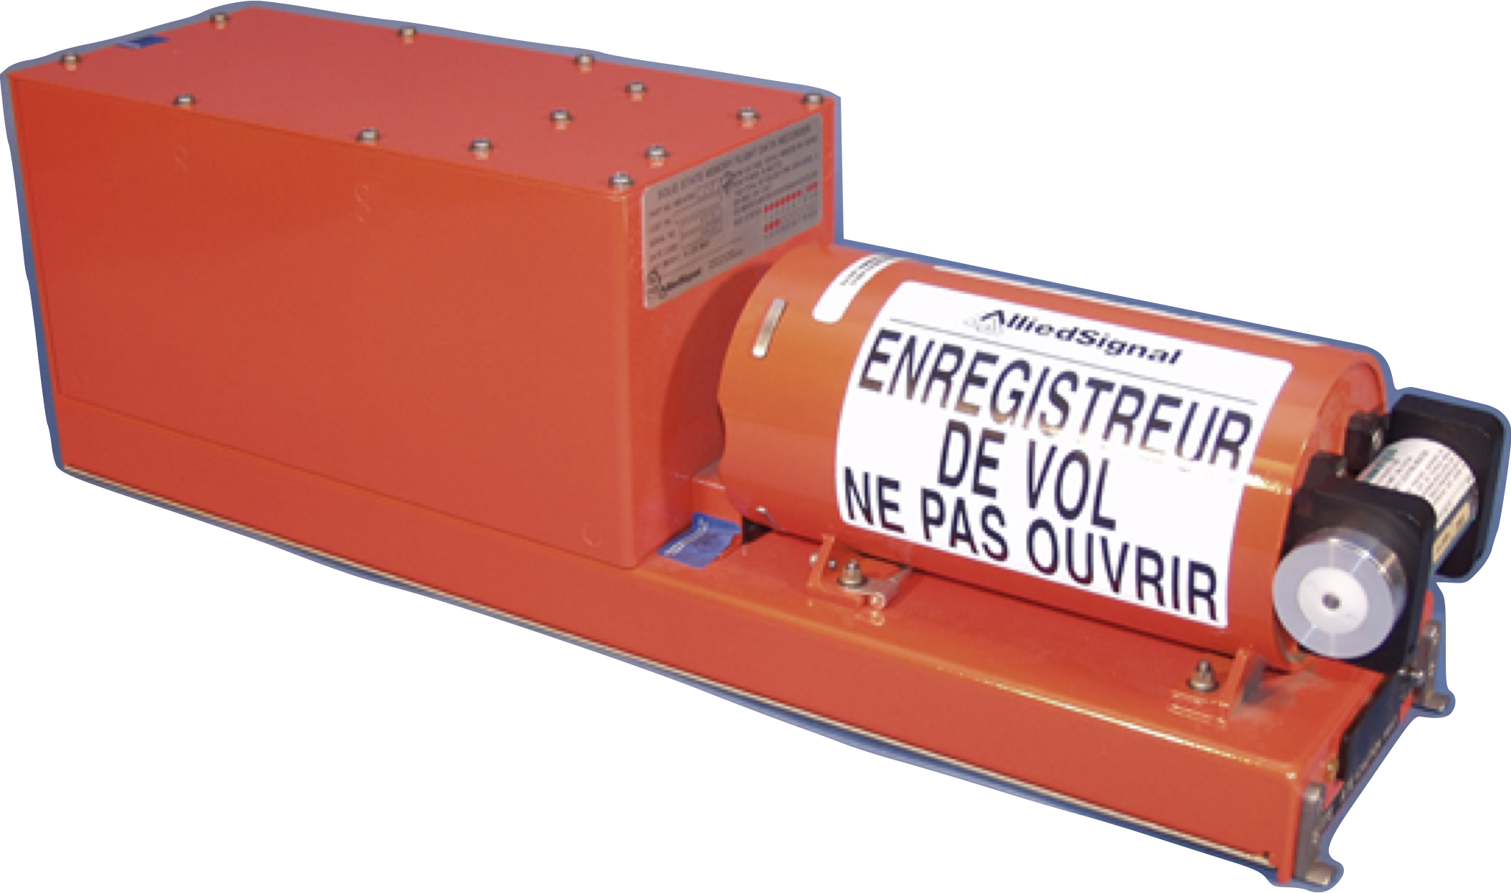
Public domain
Black holes from black boxes Rodrigo Carvajal

Slide 12
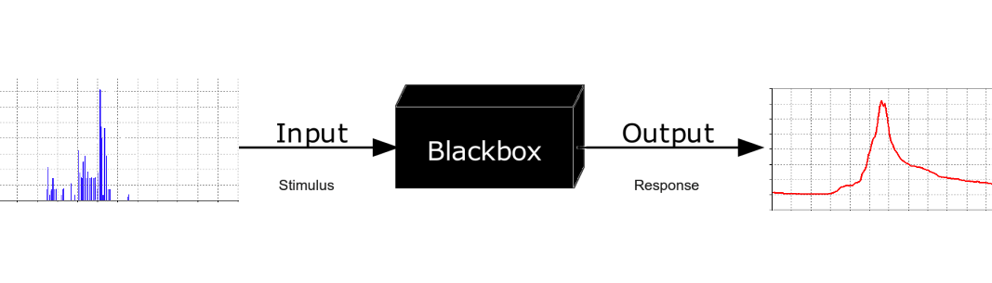
Diagram from Krauss, distributed under a CC-BY-SA 4.0 license
Black holes from black boxes Rodrigo Carvajal

Slide 13

pngwing.com
Black holes from black boxes Rodrigo Carvajal

Slide 14
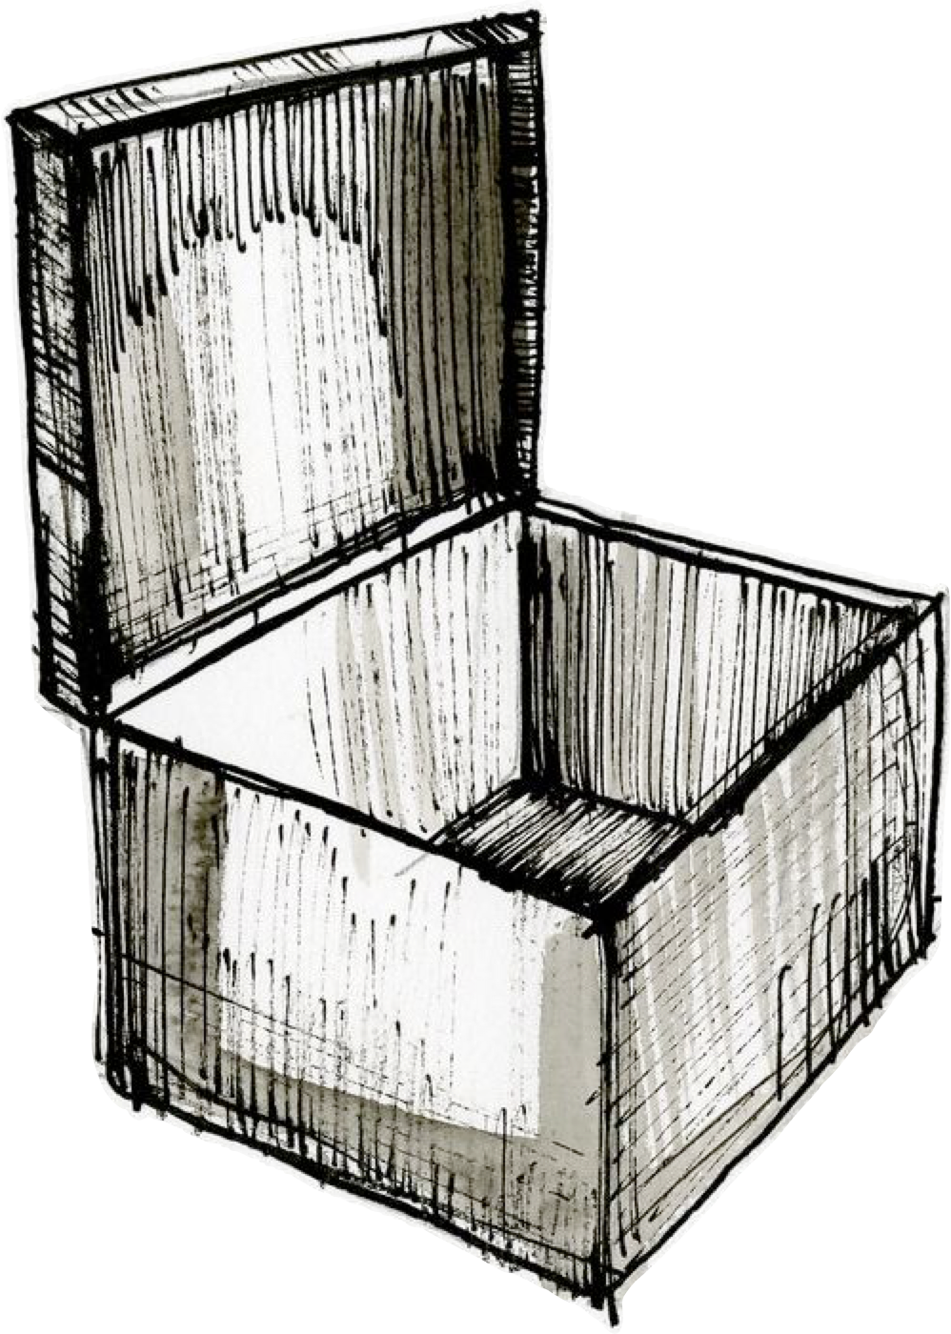
Drawing by David Ring, distributed under a CC-0 1.0 license
Black holes from black boxes Rodrigo Carvajal

Slide 15
Carvajal et al. 2023
Black holes from black boxes Rodrigo Carvajal

Slide 16
Carvajal et al. 2023
Black holes from black boxes Rodrigo Carvajal

Slide 17
Carvajal et al. 2023
Black holes from black boxes Rodrigo Carvajal

Slide 18
Carvajal et al. 2023
Black holes from black boxes Rodrigo Carvajal

Slide 19
Drawing by David Ring, distributed under a CC-0 1.0 license
Black holes from black boxes Rodrigo Carvajal

Slide 20
Carvajal et al. 2023
Black holes from black boxes Rodrigo Carvajal

Slide 21
Carvajal et al. 2023
Black holes from black boxes Rodrigo Carvajal

